Slide 1

EASTERN / SOUTHERN AFRICA
T3
Consulting TEAM 3
Data, Analytics and Insights

Slide 2
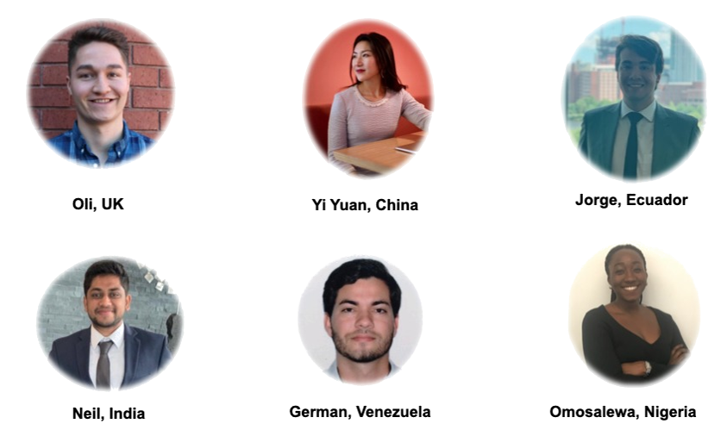
T3
CONSULTING TEAM 3
T3
Consulting TEAM 3

Slide 3
Presentation Structure
T3
Introduction to the Region
Methodology
Meta Data Analysis
Data Quality
Cleaning The Data
Sample Review
Data Quality
Adding Local Missing Values
Outliers
GDP Vs Employment
Fertility and Region Development
Conclusion
Appendix
CONSULTING TEAM 3
T3
Consulting TEAM 3

Slide 4
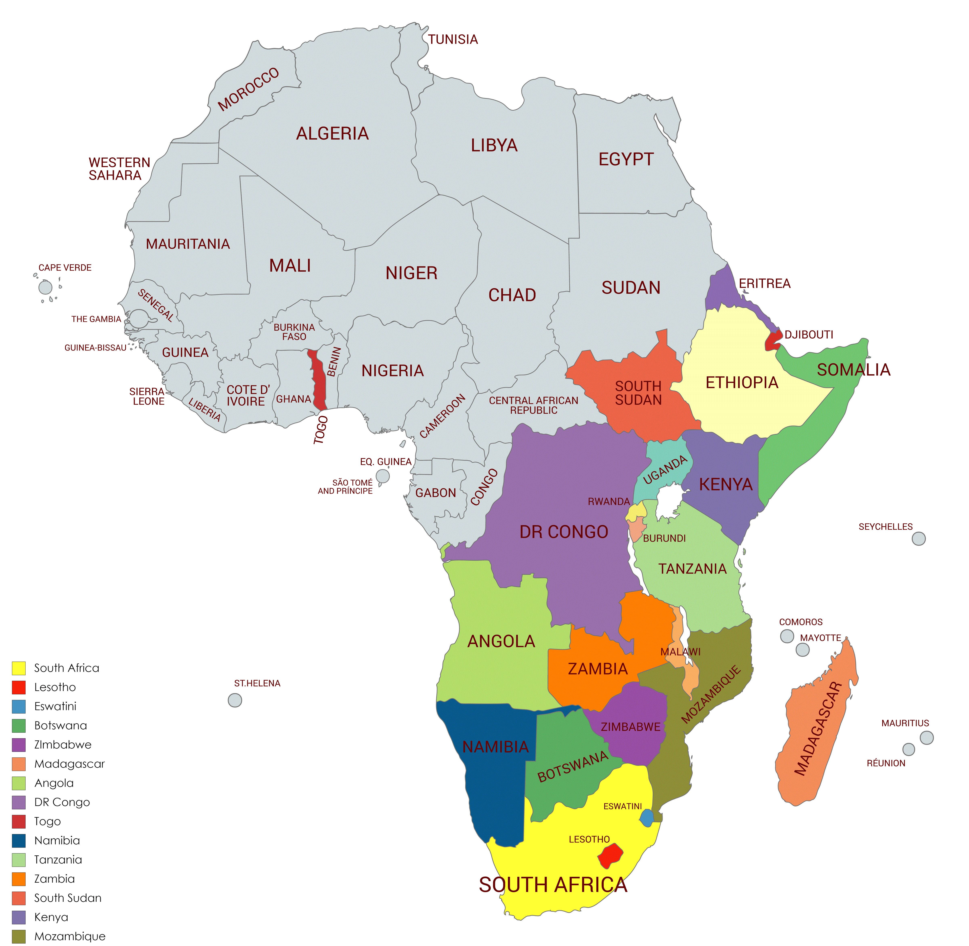
Introduction to the Region
T3
Eastern / Southern Africa
Eastern Africa
Southern Africa
Angola
Included: Geopolitics & SADC Member
Togo
Excluded: Mislabeled Region

Slide 5
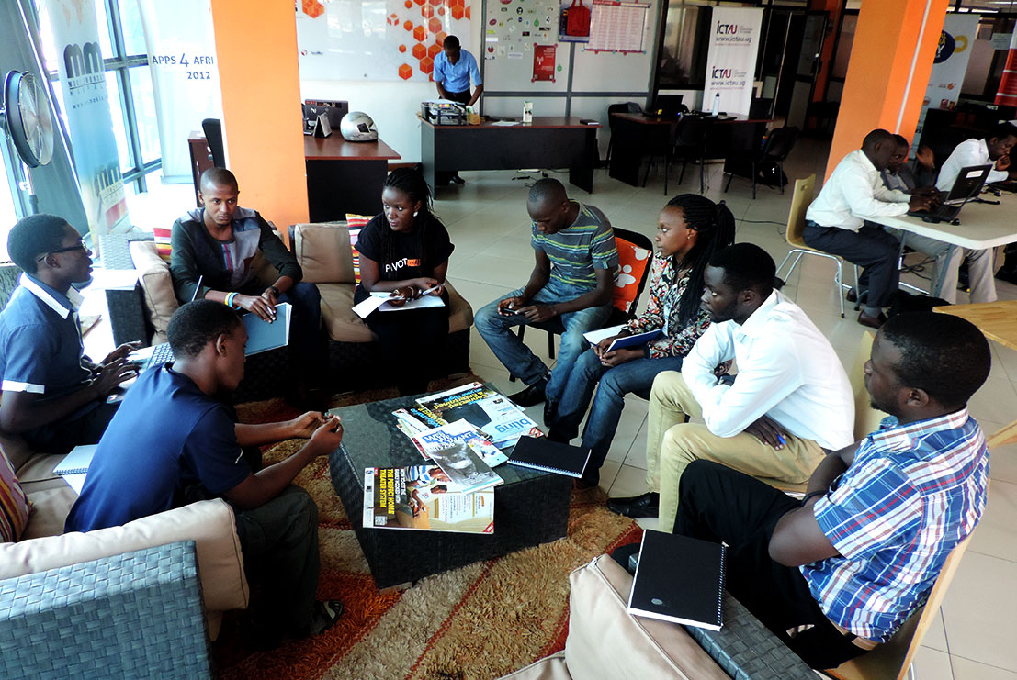
Methodology
T3
Eastern / Southern Africa
Quantitative Analysis
Data Collection & Analysis
Qualitative Analysis
Interviews to Social Capital to understand the region
Research

Slide 6
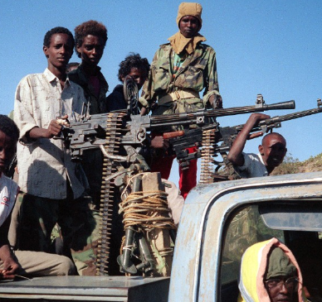
Data Quality
T3
Eastern / Southern Africa
Eritrea (2011), Party Dictatorship
Somalia (1990), Civil War since 1991
South Sudan (2016) Civil war since 2013
“As a legacy of conflict and political insecurity, Somalia lacks reliable macro and socio-economic data, making evidence-based policy-making difficult”
- World Bank Featured Story

Slide 7




Cleaning Data
T3
Eastern / Southern Africa
Sample Review
Data Quality Review
Adding Missing Values
Mean Imputation
Research
Outliers

Slide 8
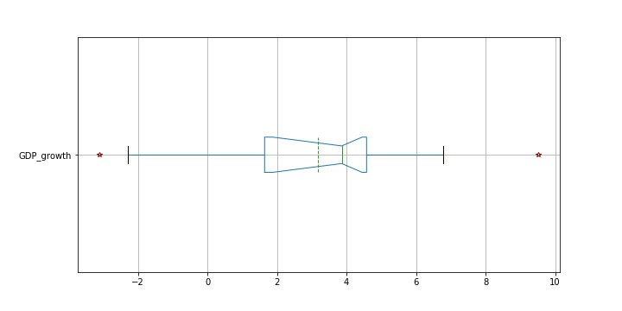
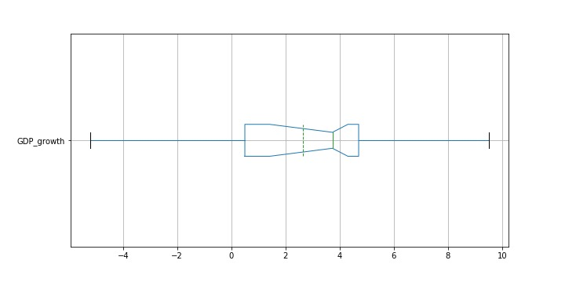
Outliers
T3
Eastern / Southern Africa
South Sudan
Ethiopia
Before
After

Slide 9
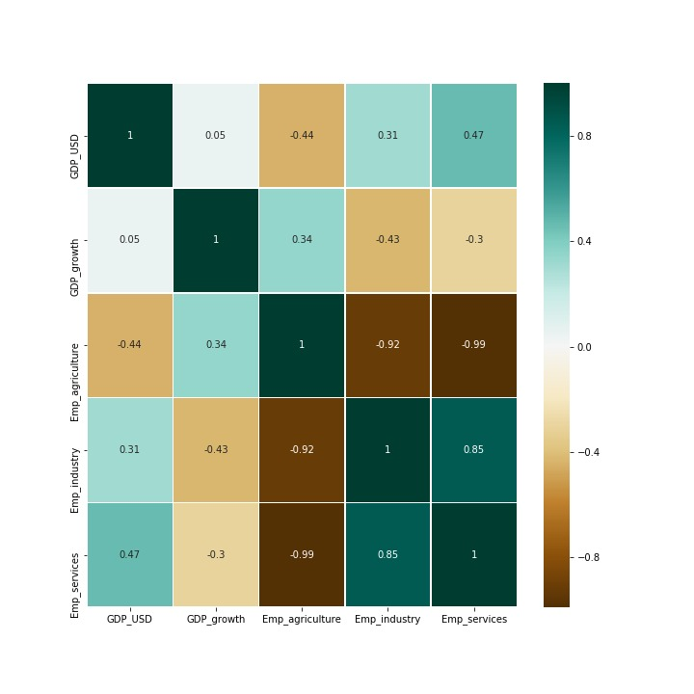
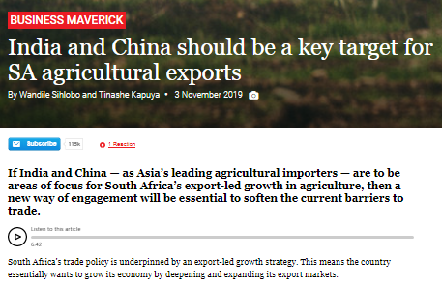
GDP Vs Employment
T3
Eastern / Southern Africa
GDP strongly associated with Industrial Sector
South Africa GDP Stall affected Industrial Employment Rates
“ despite the expected growth in the region there is gap in education, skills, policies and rights for employees to perform as expected “
– SQE @ Ford SA

Slide 10
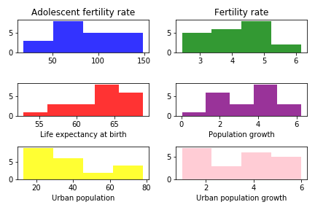
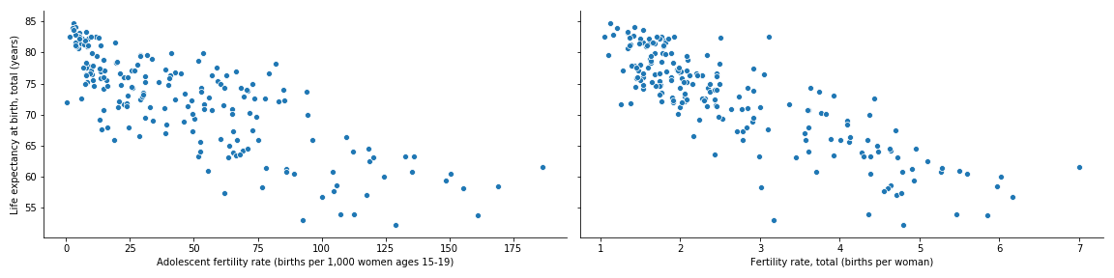
Fertility, Lifespan and Region Development
T3
Eastern / Southern Africa
Fewer childbearing might mean more disposable resources and improved life expectancy.
Female education attainment, family planning, reduced child mortality, and access to work opportunities are all significant factors.
“ population growth is a complex issue in the region despite the current development in some areas. Education will be important for the newest generations and we should prepare them to be ready for the new challenges“
– Executive @ Visteon SA Py

Slide 11
Wrap Up
T3
Eastern / Southern Africa Development Ideas
Regional opportunities by promoting agriculture (food), health care, education, regional integration, invest in employment, and economic diversification.
Insight 1
Insight 2
Insight 3
Without proper investment in Electricity economic growth will be difficult
Health Care and Education investments To support population growth.
Diversifying Economy

Slide 12

Thank You.
T3
FR
Consulting TEAM 3
FABRIKAM RESIDENCES

Slide 13
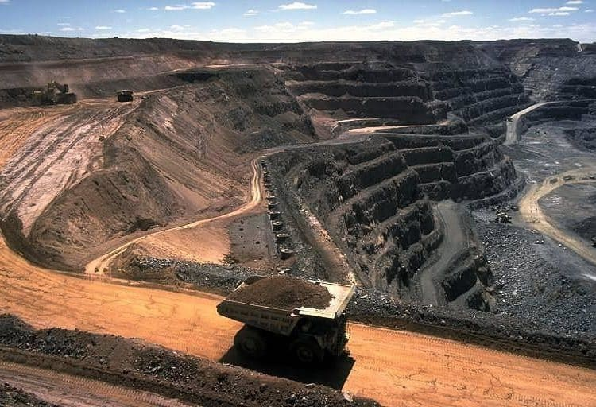
APPENDIX
T3

Slide 14
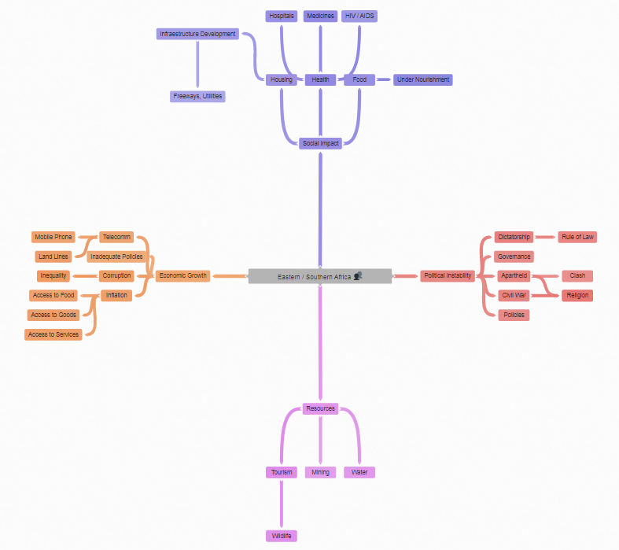
Appendix 1 – Qualitative
T3
Link= Qualitative Diagram
Interviewee Profile
Former Supply Chain Manager
General Motors South Africa (defunct)
Former Manufacturing Executive
Visteon South Africa Pty (defunct)
Supplier Quality Engineer
Ford South Africa

Slide 15
Appendix 2 – Coding
T3
Python
Resources
Pandas
Matplotlib
Seaborn
World Bank Data

Slide 16
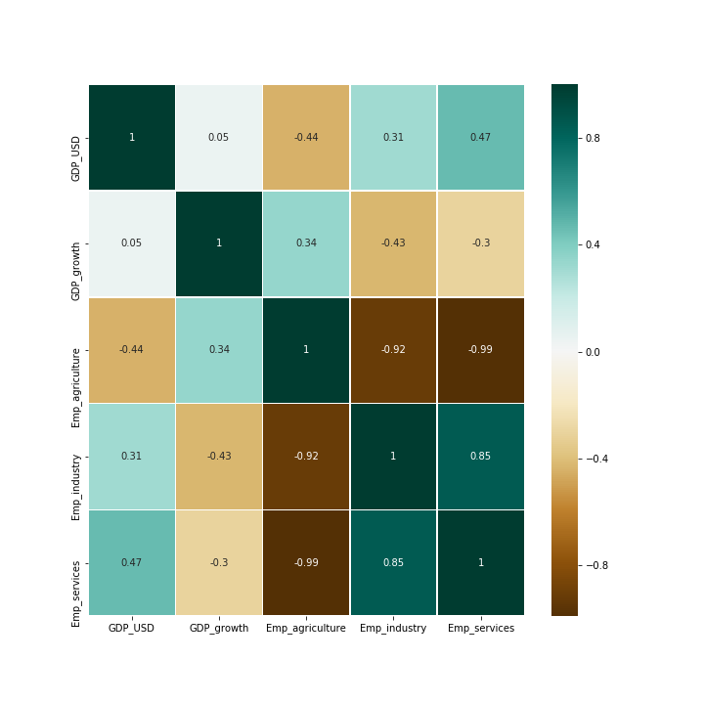
Appendix 3.B – Graphs & Code
T3
GDP Eastern / Southern Africa
Industry Impact on GDP

Slide 17
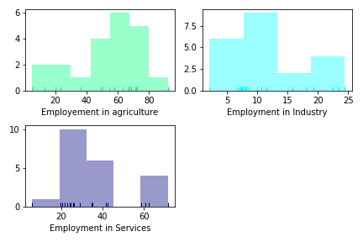
Appendix 3.B – Graphs & Code
T3
GDP Eastern / Southern Africa
Employment Analysis
Histograms
Employment in Agriculture
Employment in Industry
Employment in Services

Slide 18
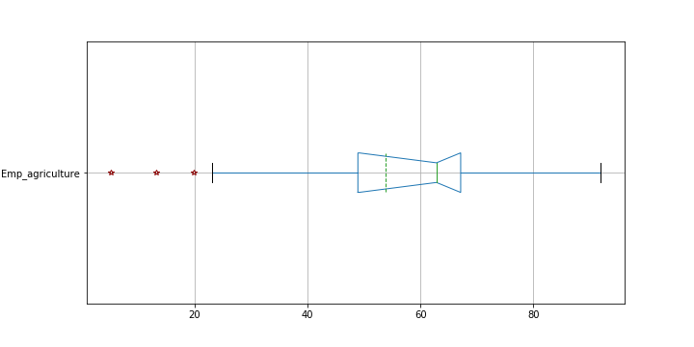
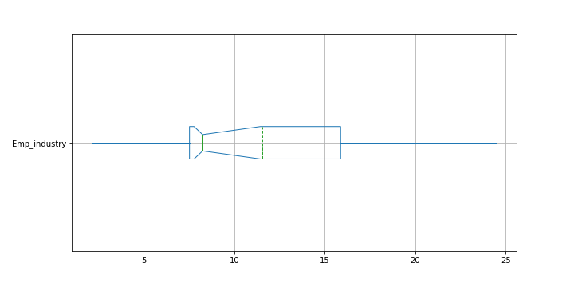
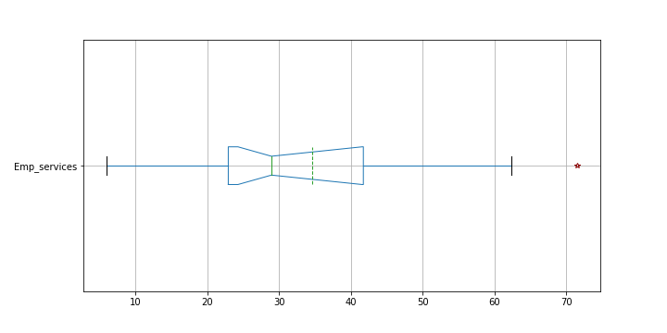
Appendix 3.B – Graphs & Code
T3
GDP Eastern / Southern Africa
Employment Analysis
Nulla a erat eget nunc hendrerit ultrices
Sed in molestie est. Cras ornare turpis at
Sector Employment Vs GDP
Employment in Agriculture
Employment in Industry
Employment in Services

Slide 19
Appendix 4 – Countries
T3
Eastern / Southern Africa
Eastern / Southern Africa
Botswana
Burundi
Republic of Congo
Djibouti
Eritrea
Eswatini
Ethiopia
Kenya
Lesotho
Magadascar
Malawi
Mozambique
Namibia
Rwanda
Somalia
South Africa
South Sudan
Tanzania
Uganda
Zambia
Zimbabwe
And…
Angola

Slide 20
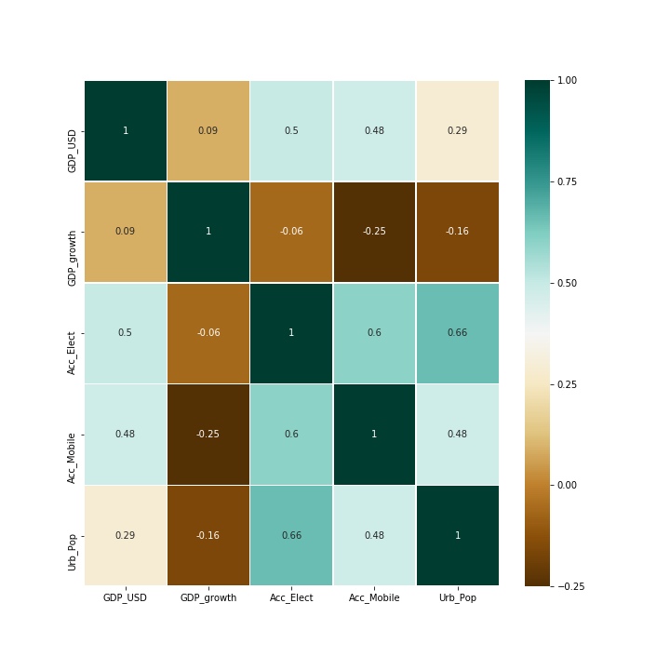
Appendix 5 - Electrifying Africa
T3
Eastern / Southern Africa
Mobile Data as support for new and sustainable Electrification Projects.
“ people usually have one or two mobile phones and they are willing to commute to get signal or charge “
– Former Manager @ General Motors SA

Slide 21
Appendix 6 - References
T3
Eastern / Southern Africa
Data & Information
Images
https://www.cia.gov/library/publications/the-world-factbook/
https://data.worldbank.org/
https://datahelpdesk.worldbank.org/
https://www.cia.gov/library/publications/the-world-factbook/geos/print_od.html
https://freedomhouse.org/report/freedom-world/2019/eritrea
http://necrometrics.com/20c300k.htm#Somalia
https://www.cia.gov/library/publications/the-world-factbook/geos/print_er.html
https://www.mckinsey.com/industries/electric-power-and-natural-gas/our-insights/powering-africa
https://www.worldbank.org/en/news/feature/2015/10/15/measuring-poverty-in-60-minutes-to-help-somalia-address-data-deprivation
https://www.caravansa.co.za/parks-of-the-great-escarpment/
https://www.thesouthafrican.com/news/coal-mining-south-africa-world-heritage-site/
https://www.pri.org/stories/2011-11-09/africa-fastest-growing-mobile-market-world-industry-group-said

